Slide 1

A Basic Neural Net Trevor Santiago 4051512
Motivation:
Personal interest in data science/machine learning
Learn the basics of ANN’s for building upon later
Problem:
Attempt creation of my first ever network
Estimate a sine wave
Use gradient descent to improve accuracy

Slide 2
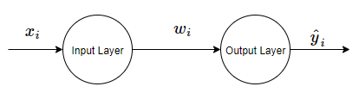
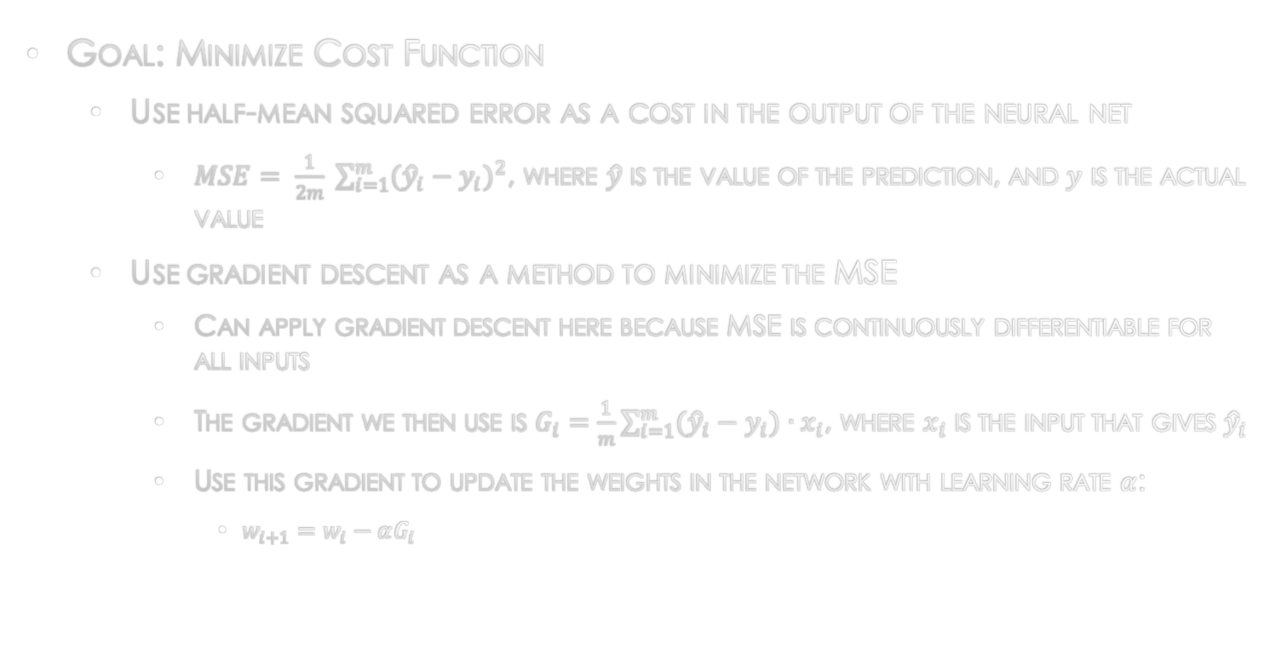
Methods
Goal: Minimize Cost Function
Use half-mean squared error as a cost in the output of the neural net
$MSE= \frac{1}{2m} \sum_{i=1}^{m}{{({\hat{y}}_{i}−y_{i})}^{2}}$, where $\hat{y}$ is the value of the prediction, and $y$ is the actual value
Use gradient descent as a method to minimize the MSE
Can apply gradient descent here because MSE is continuously differentiable for all inputs
The gradient we then use is $G_{i}=\frac{1}{m}\sum_{i=1}^{m}{({\hat{y}}_{i}−y_{i})∙x_{i}}$, where $x_{i}$ is the input that gives ${\hat{y}}_{i}$
Use this gradient to update the weights in the network with learning rate $α$:
$w_{i+1}=w_{i}−αG_{i}$

Slide 3
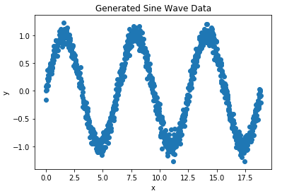
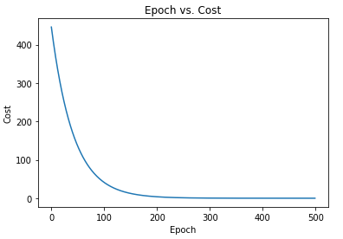
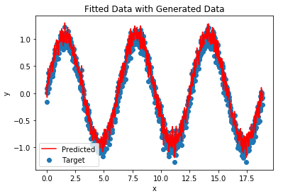
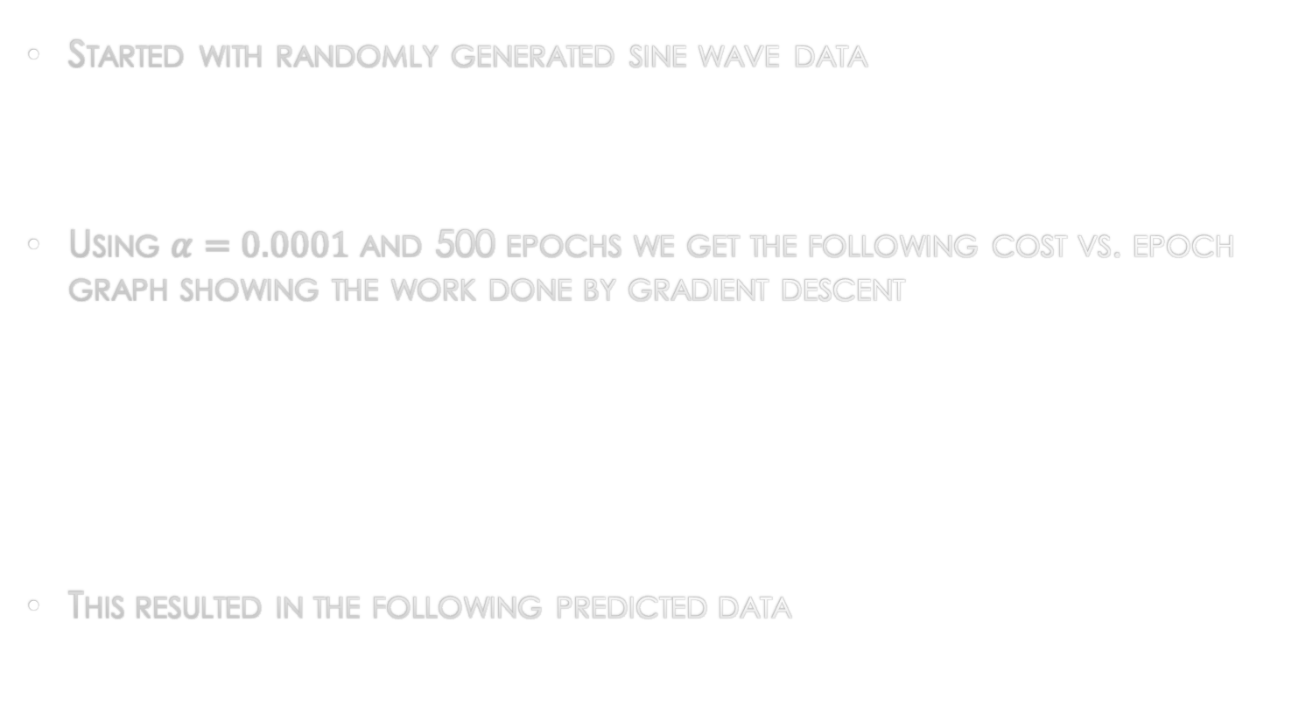
Results
Started with randomly generated sine wave data
Using $α=0.0001$ and 500 epochs we get the following cost vs. epoch graph showing the work done by gradient descent
This resulted in the following predicted data

